Slide 1
Harddisk Read/Write
Accessing the hard disk is slow.
While all CPU instructions are purely electronic, the hard disk is mechanical.
CPU instructions run on the order of nanoseconds. (nano = 10⁻⁹)
Hard disk accesses can run on the order of milliseconds. (milli = 10⁻³)
Fewer hard disk accesses is better.

Slide 2
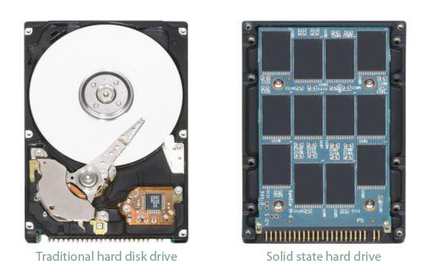

Hard Drives

Slide 3
Buffers
A “buffer” is just a section of RAM that saves data that you are currently working on that has not yet been “finalized”.
The Buffered object actually does the hard disk read/writes at some convenient time for the OS and hardware.
Can be done concurrently with CPU instructions! This means no lost time for reads or writes!

Slide 4
StringBuffer
Represents a string of characters as a mutable object
Constructors:
  StringBuffer() // empty StringBuffer of the default capacity
  StringBuffer(n) // empty StringBuffer of a given capacity
  StringBuffer(str) // converts str into a StringBuffer
Adds setCharAt, insert, append, and delete methods
The toString method converts this StringBuffer into a String

Slide 5
Encryption
Find the Ciphers file on SchoolLoop. Read up on each of the 3.
Choose one.
Download the posted class called Crypt. You are responsible for two methods:
public void encrypt(String inputFilename, String outputFilename, String keyword)
public void decrypt(String inputFilename, String outputFilename, String keyword)

Slide 6
Encryption
The encrypt method will perform the algorithm specified, and the decrypt will reverse the algorithm, restoring the original file.
This will involve File IO, but the algorithm is supplied for you (unlike Netflix Prize).
For this reason, the algorithm is not the focus of the assignment. In addition to creating a functional product, your Crypt class is shooting for speed.

Slide 7
Crypt
Structural Requirements:
  2 methods with headers that exactly match those originally in Crypt
  Encrypting then decrypting produces the original
  Encrypting produces a text file that matches the provided sample for Romeo
Style Requirements:
  When doing File I/O, Buffered classes must be used
  When encrypting/decrypting, work must be done simultaneously with File I/O
  In all data modification situations, a mutable data type (such as StringBuffers) must be used in place of Strings

Slide 8
The Contest
If you fit this, you are eligible for…
  The Contest (run time for tester unknown):
    Monoalphabet – 1 winner
    Vigenere cipher – 2 winners
    Playfair cipher – 3 winners

